Slide 1
CONTINOUS DELIVERY
Training

Slide 2
Agenda
The roots of continuous delivery
Business, testing and development teams collaboration
Software craftmanship
Development and ops teams collaboration
Measurement and monitoring
Conclusion

Slide 3
The roots of continuous delivery

Slide 4
Definition
"Continuous delivery is a set of principles and practices to reduce the cost, time, and risk of delivering incremental changes to users."
Martin Fowler
Our highest priority is to satisfy the customer through early and continuous delivery of valuable software.
Agile Manifesto
More than a buzzword, continuous delivery is a matter of survival for any IT company in the next years
Sedat G.

Slide 5


















Definition : who?
PIONEERS
ENABLERS
FOLLOWERS

Slide 6

Definition : why?
Faster time to market => Competitive advantage
Better quality of product => Higher customer satisfaction
Expected features delivered
Processes optimized => Reduced TCO (total cost of ownership)

Slide 7
Definition : What?
Continuous delivery combines many approaches and processes:
Business, testing and development teams collaboration
scrum/kanban product backlog management
Software craftsmanship
behavior driven development/test driven development
continuous integration/testing
clean code/refactoring/loose coupling
Development and operational teams collaboration
Build once run everywhere
Automated deployment
Infrastructure as code
Full versioning strategy
Release pipeline
Measurement and monitoring
time to market measurement
feature usage tracking

Slide 8
Definition : how?
Deploying continuous delivery in an organisation implies:
Cultural changes (breaking the wall, citizenship over RACI)
Evangelists team able to ease the change of mind (coaches, experts)
Full commitment from management AND business sponsors
And …
A set of processes and tools to support the mindset

Slide 9
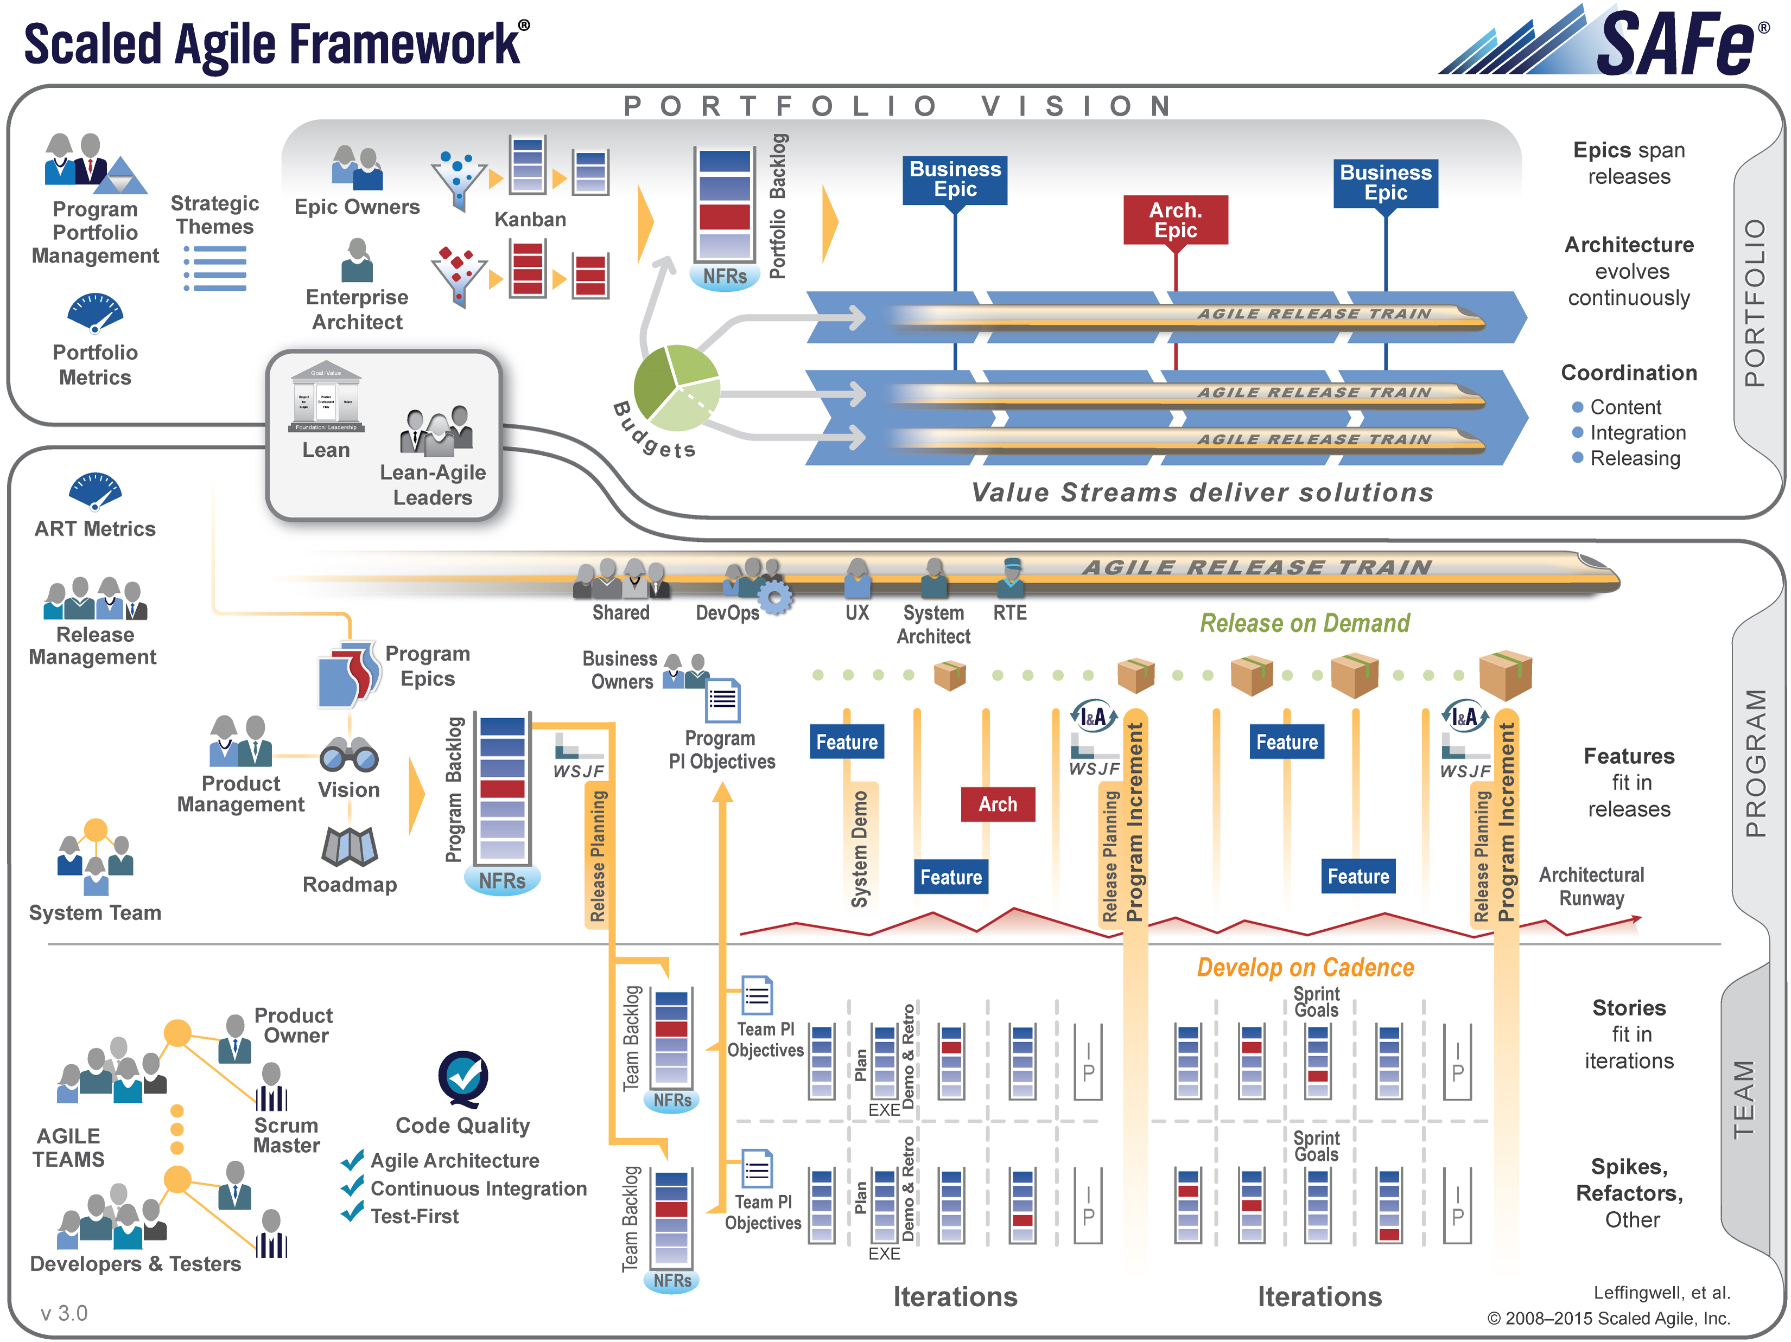
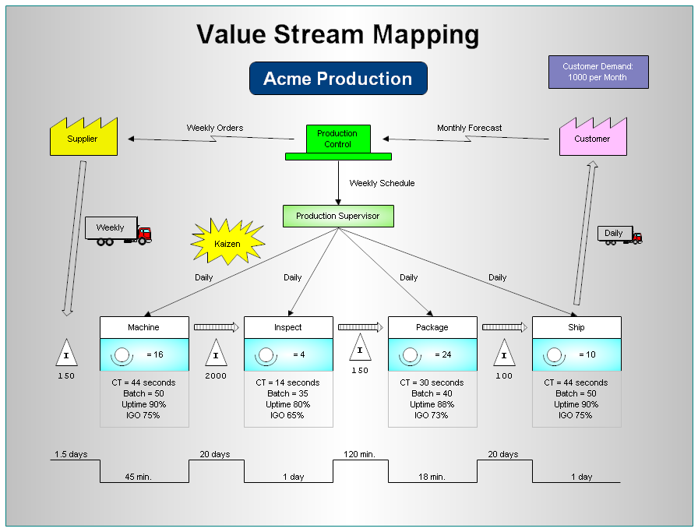
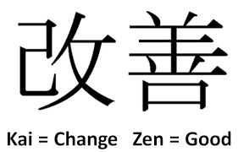
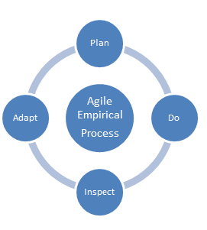
Definition : an implementation model
SAFE (Scaled Agile For Enterprise) framework http://www.scaledagileframework.com
Lean and agile inspired
Value stream map
Continuous improvement (kaizen, inspect & adapt)

Slide 10
Definition : legacy versus target organization
Infrastructure
Architecture
Operations
Development
Continuous Delivery Program Governance
Infrastructure transversal team
Architecture transversal team
IT as a Service
Continuous delivery platform
CHANGE
THE
RULES
DBAs
Technical
QA
Front-Office
FEATURE TEAM « FRONT »
- MANAGEMENT
- COACHES
BUSINESS
FEATURE TEAM « BACK »
- MANAGEMENT
- COACHES
BUSINESS
FEATURE TEAM « RISK »
- MANAGEMENT
- COACHES
BUSINESS
DEVLEOPERS
QUALITY ASSURANCE
OPERATIONS
DEVELOPERS
QUALITY ASSURANCE
OPERATIONS
DEVELOPERS
QUALITY ASSURANCE
OPERATIONS
Release Management
Back-Office
Sys Admins
Functional
Risk Referential Finance
Developmentv & Operations
« feature teams »
Preprod
Network
Financing
Production
Data
Compliance
Middleware
Support by BU
…

Slide 11
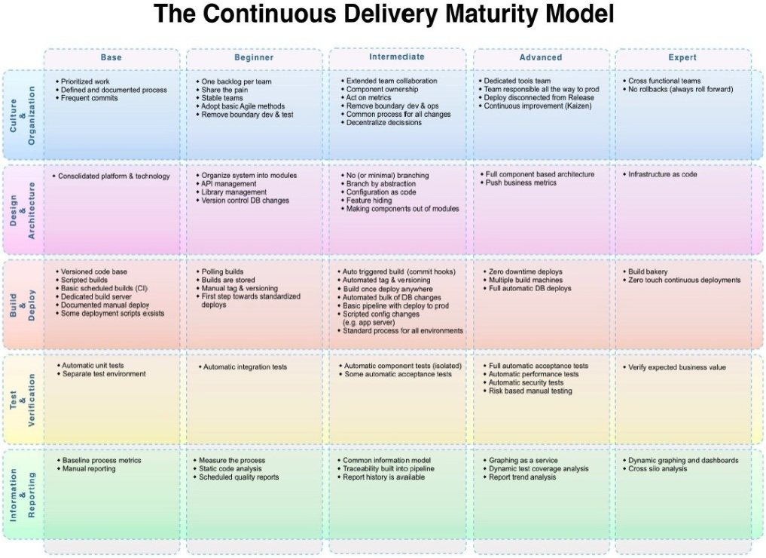
Definition : continuous delivery adoption
How to adopt continuous delivery?
Define a maturity model (c.f. sample)
Assess applications : current/target level, pain points, value stream map, business objectives
Define the transformation plan : axis of improvement against the target level chosen, planning, budget...
Once the transformation contract is validated by all stakeholders, go for coaching/training/transformation steps
Validate the completion

Slide 12
Practices and tools
Business, testing and development teams collaboration

Slide 13
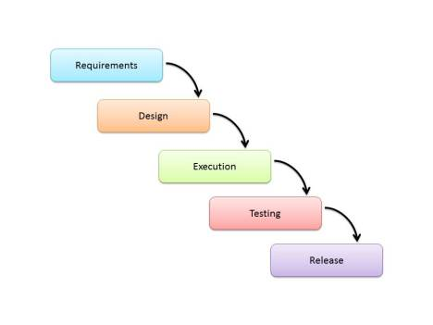
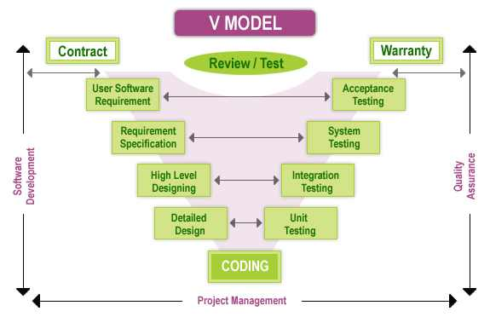
Before agility : waterfall / V-cycle

Slide 14

Before agility : waterfall / V-cycle
Fits well for developments having:
Stable product definition
Well defined, non ambiguous requirements
Stable, masterized technology
As many expertise and resources as necessary
DO THESE KIND OF DEVELOPMENTS STILL EXIST ?

Slide 15
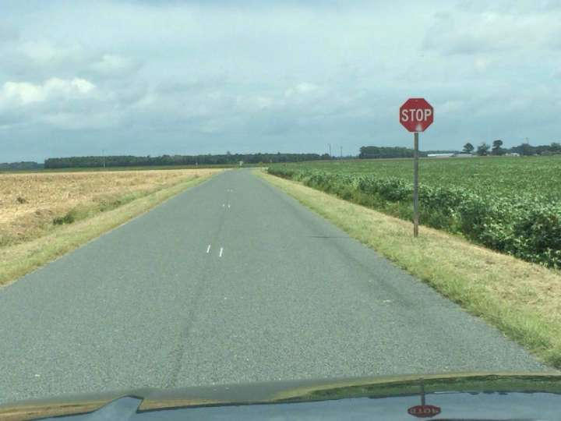
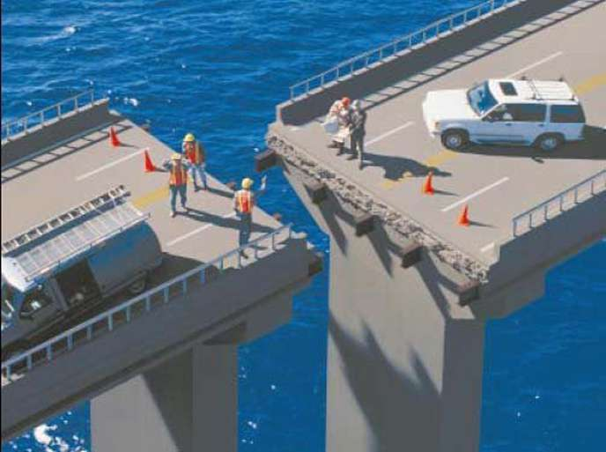
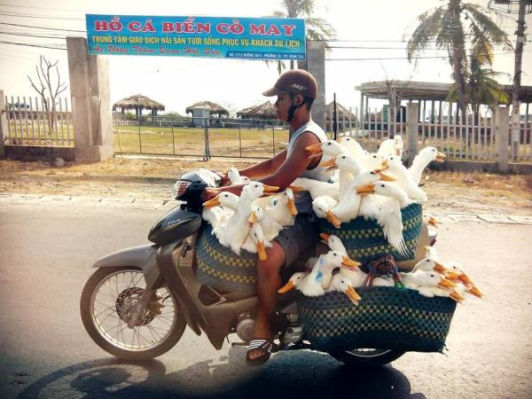
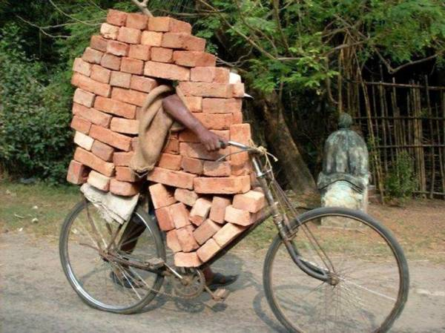
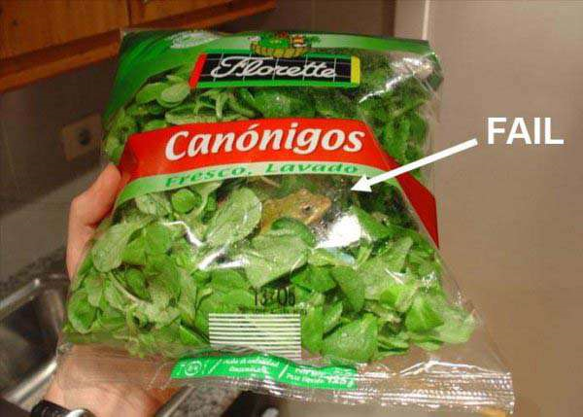

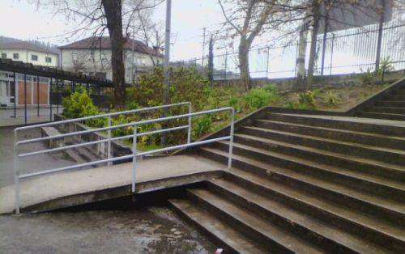
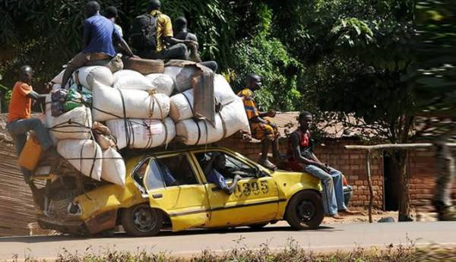
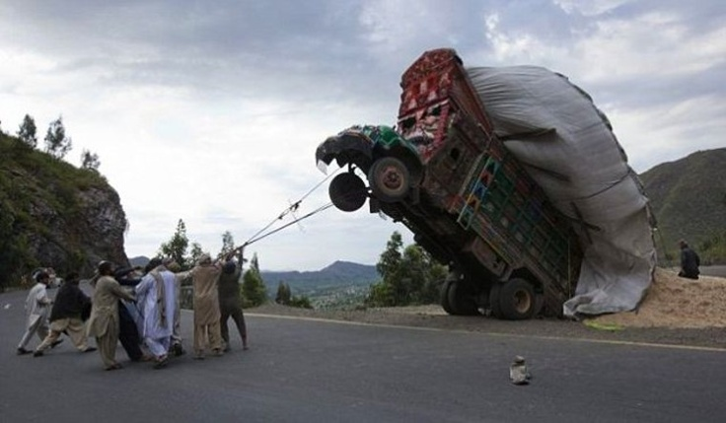
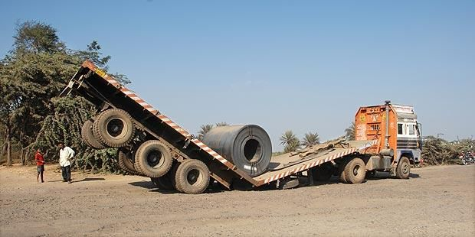
Before agility : the real thing
With waterfall/V cycle approaches:
lack of visibility,
added to unmanageable workload,
often lead to errors discovered too late.
Despite many desperate task forces,
produced code remains unstable,
causing multiple integration conflicts,
leading to issues in production,
sometimes seen by the end users.
Finally, the client, furious,
decides to freeze the project.

Slide 16
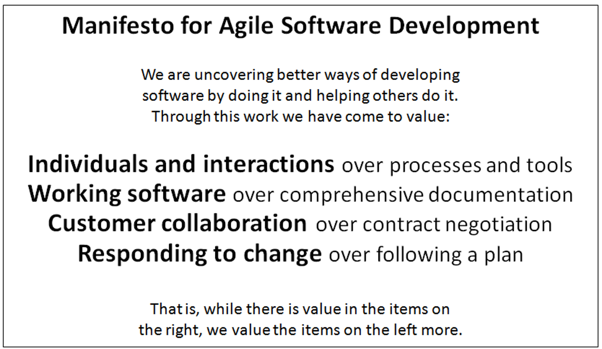
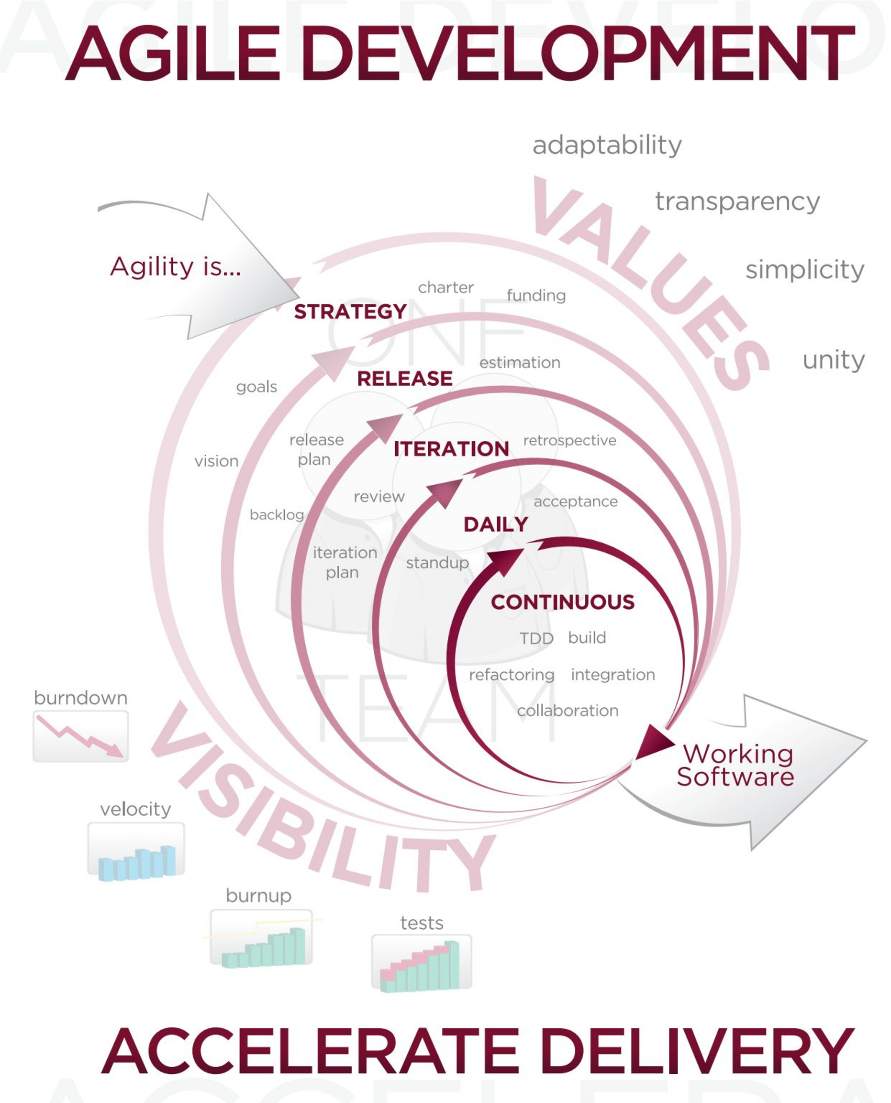
Here comes the agility (2001)

Slide 17
Continuous delivery is agility
Principles of agility:
1. Our highest priority is to satisfy the customer through early and continuous delivery of valuable software.
2. Welcome changing requirements, even late in development. Agile processes harness change for the customer's competitive advantage.
3. Deliver working software frequently, from a couple of weeks to a couple of months, with a preference to the shorter timescale.
4. Business people and developers must work together daily throughout the project.
5. Build projects around motivated individuals. Give them the environment and support they need, and trust them to get the job done.
6. The most efficient and effective method of conveying information to and within a development team is face-to-face conversation.
7. Working software is the primary measure of progress.
8. Agile processes promote sustainable development. The sponsors, developers, and users should be able to maintain a constant pace indefinitely.
9. Continuous attention to technical excellence and good design enhances agility.
10. Simplicity--the art of maximizing the amount of work not done--is essential.
11. The best architectures, requirements, and designs emerge from self-organizing teams.
12. At regular intervals, the team reflects on how to become more effective, then tunes and adjusts its behavior accordingly.

Slide 18
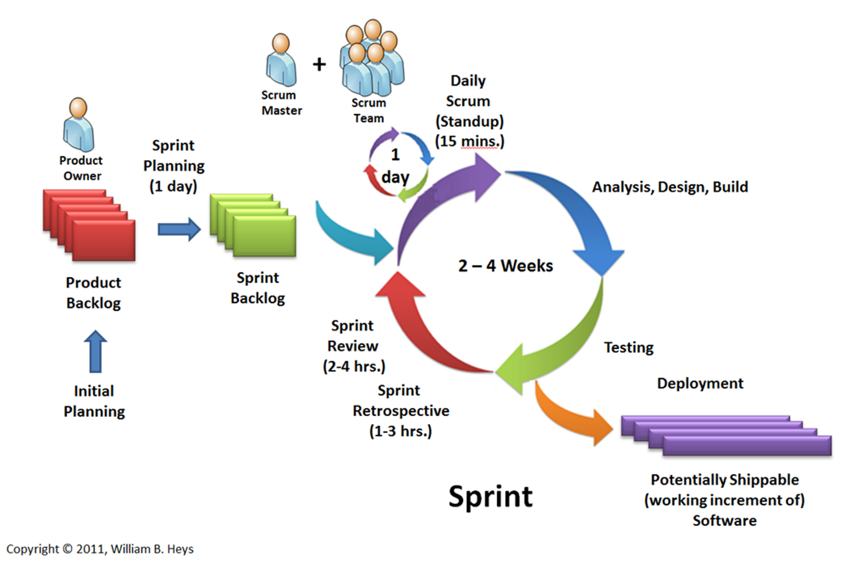
Scrum : roles and workflow
3 main roles :
Product owner : backlog definition and follow-up according to customer needs
Scrum master : in charge for scrum adoption, adaptation and following in the project team
Team : self-sufficient, self-managed pool of business analysts, developers, testers in charge for the product build and delivery

Slide 19
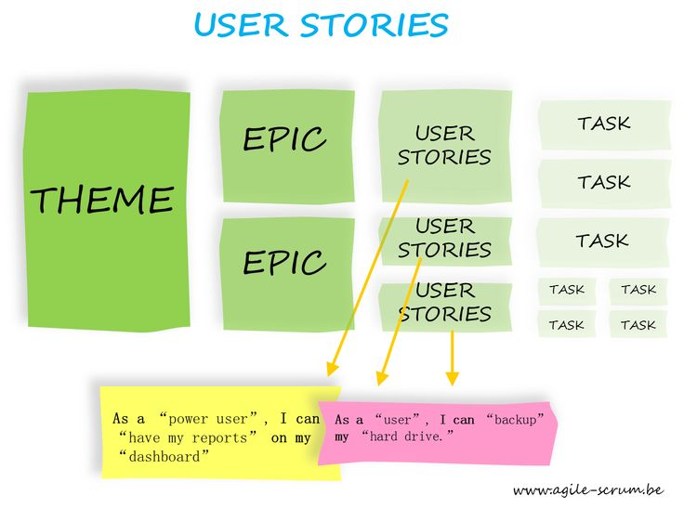
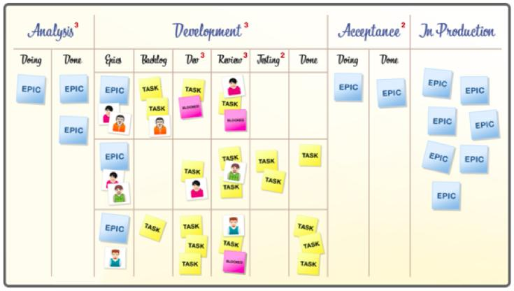
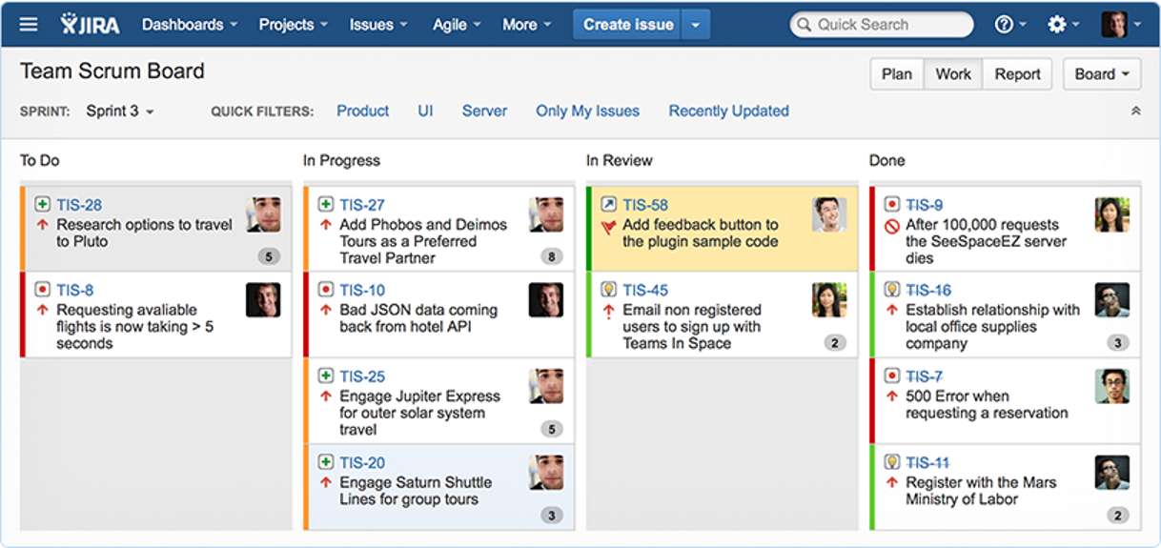
Scrum : work units definition and follow-up dashboard

Slide 20
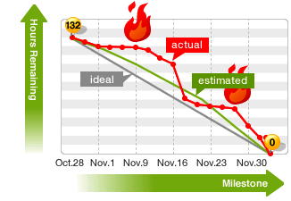
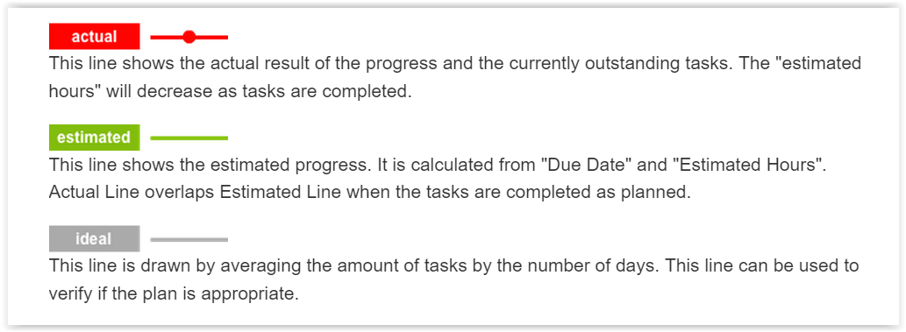
Scrum : measurement
Units of work = story points
T shirt size, Fibonacci suite…
Capacity of the team = velocity
#story points/sprint
Follow-up = burndown chart

Slide 21
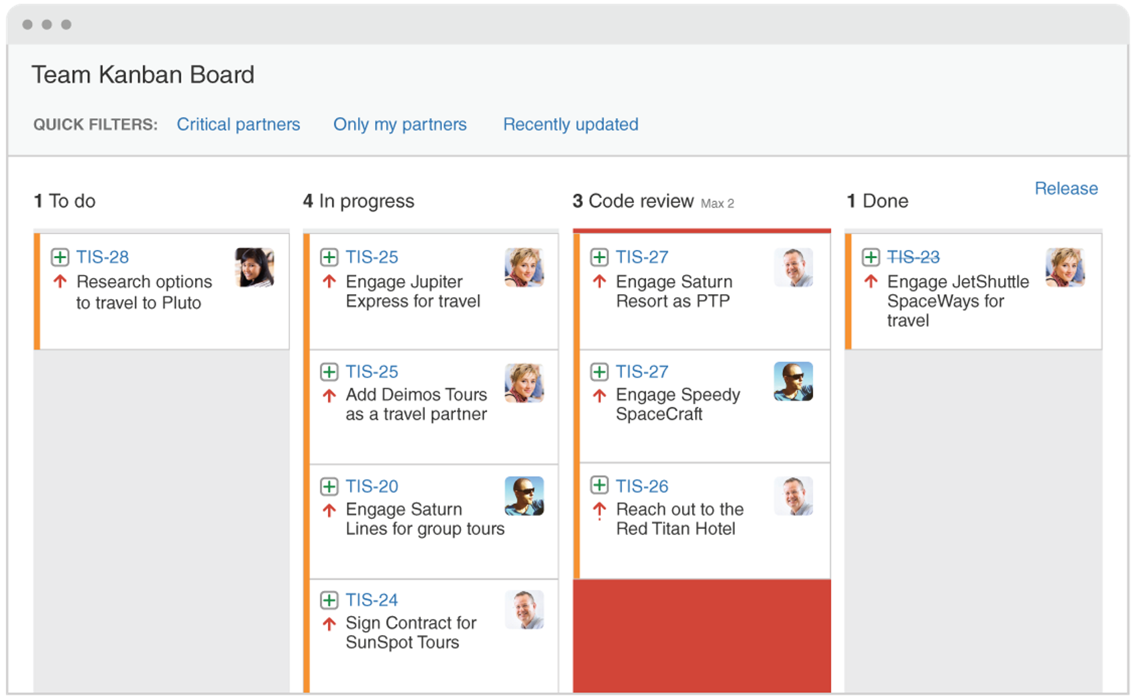
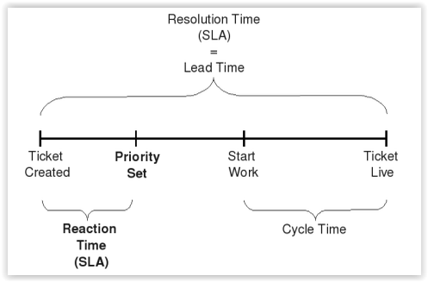
Kanban : principles
Lean-inspired (Toyota)
Flow-oriented
Focuses on current work
No roles/ceremonials
Lead/Cycle time

Slide 22
Scrum vs Kanban : which one?
 | SCRUM | KANBAN
Cadence | Regular fixed length sprints (ie, 2 weeks) | Continuous flow
Release methodology | At the end of each sprint if approved by the product owner | Continuous delivery or at the team's discretion
Roles | Product owner, scrum master, development team | No existing roles. Some teams enlist the help of an agile coach.
Key metrics | Velocity | Cycle time
Change philosophy | Teams should strive to not make changes to the sprint forecast during the sprint. Doing so compromises learnings around estimation. | Change can happen at any time

Slide 23
Adapt your implementation : SGCIB ARC COC
Our team :
Experienced, multi technologic, transversal team
15 members, mostly Finaxys members (+ 10 SG Bangalore teammates)
Extended scope of activities : training, expertise, coaching, support, development…
Limited internal baseline financing
Almost all requests are external (technical domain owners, users, management)

Slide 24
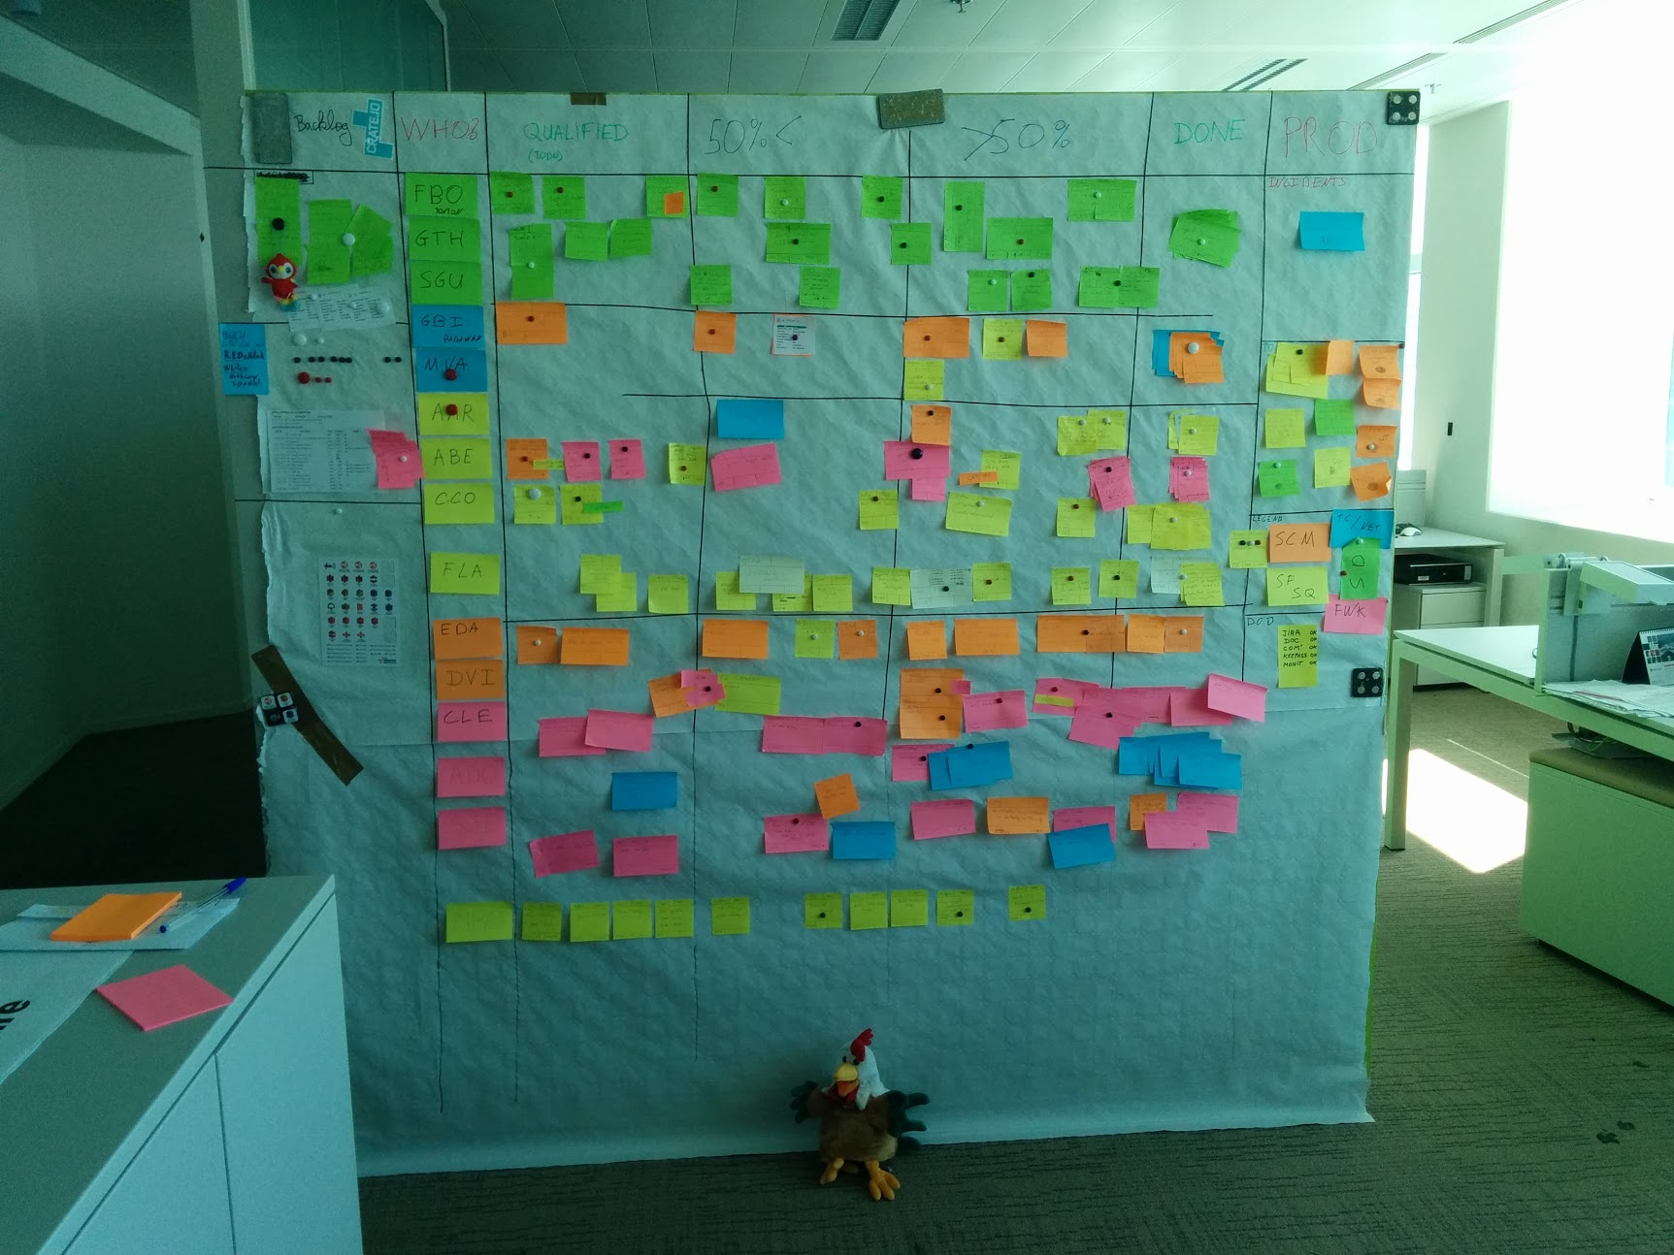



Adapt your implementation : SGCIB ARC COC
Our implementation :
Kanban-like board
Daily meetings “à la scrum”
Individual follow-up
No limit per status

Slide 25





Agility : the sum up
Business analysts + developers = same team !
Fast feedback means : expected features in time
Mutual trust is not a gift but a reward
Business/developers collaboration is a marathon
Choose agile method appropriate to your context!
INSPECT
AND
ADAPT!

Slide 26
Practices and tools
Software craftmanship

Slide 27
Definition : Raising the bar
“Any fool can write code that a computer can understand. Good programmers write code that human can understand« Martin Fowler
Manifesto for Software Craftmanship: http://manifesto.softwarecraftsmanship.org/#/en
As aspiring Software Craftsmen we are raising the bar of professional software development by practicing it and helping others learn the craft.

Slide 28

Definition : Raising the bar
Through this work we have come to value:
Not only working software, but also well-crafted software
Not only responding to change, but also steadily adding value
Not only individuals and interactions, but also a community of professionals
Not only customer collaboration, but also productive partnerships

Slide 29
CRAFTMANSHIP MAIN PRACTICES « Build the right thing, build it right »
Behavior-Driven Development (BDD) A specification technique to improve communication between PO/BA, QA and Dev team thanks to business-facing scenarios that also act as automated tests.
Test Driven Development (TDD) A Design technique to craft simple code, cheaper to maintain and evolve; also the only path to very high test coverage
Testing and refactoring Legacy code Special techniques to deal with the complex challenges of legacy code: hard to test, obscure, hard to change
Continuous Delivery A set of practices from continuous integration to automated deployment, to make deployment to production a non-event, as often as desired

Slide 30
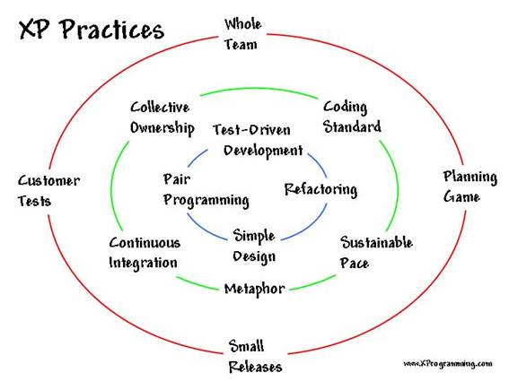
CRAFTMANSHIP PRACTICES AND PROCESSES eXtreme Programming principles
« We are one » : collective ownership, pair programming/review, feedbacks, coding dojos…
Communication-oriented
Small iterations => cheaper and safer
Continuous refactoring and simplicity
Testing culture : BDD/TDD
Continuous integration
Code quality matters
Everything is versionned

Slide 31
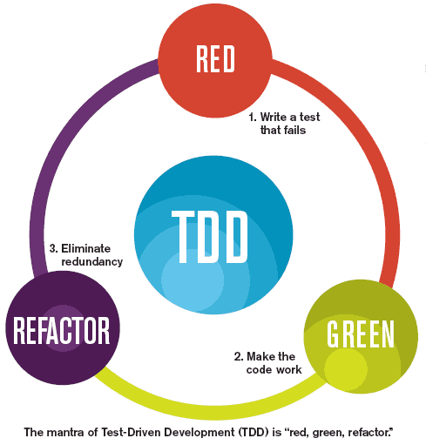
CRAFTMANSHIP PRACTICES AND PROCESSES eXtreme Programming : TDD
How to be sure of a feature result? Test it
Write the test : we assert what the code should do
Run the test => it must fail
Write the code to test and run the test again
It should run, unless correct code/test until it does so
Refactor the code/tests
Fits well for technical behaviour validation (mocked unit tests)
Code coverage can be costly to increase and hard to detect (mutation tests)

Slide 32
CRAFTMANSHIP PRACTICES AND PROCESSES eXtreme Programming : BDD
How to be sure of a feature result? Describe, then test it …
A common langage (glossary) is defined between business and developers
Features are described together between business, developers and QA
Specific pattern : Given <initial-states>, When <events> Then <results-of-events>
In the end, we run … tests, so?
BDD is aimed to describe, implement and test features
TDD is aimed to implement and test code parts

Slide 33
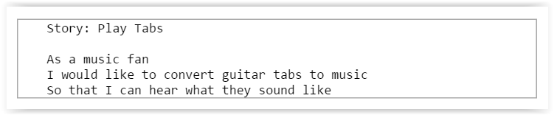
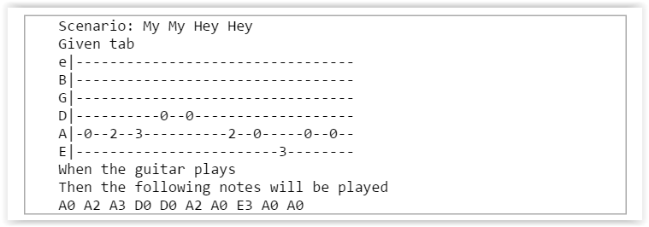
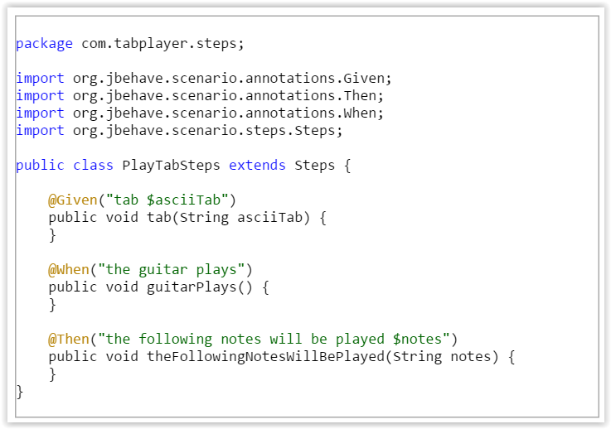
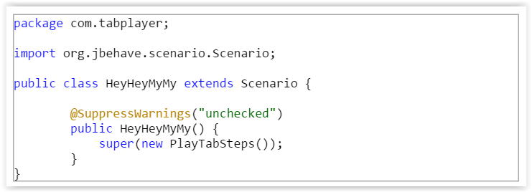
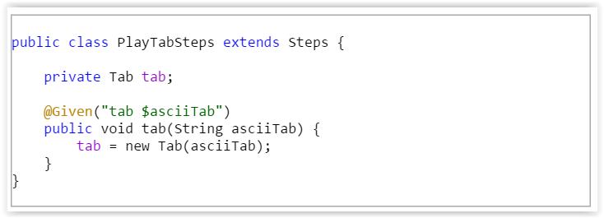
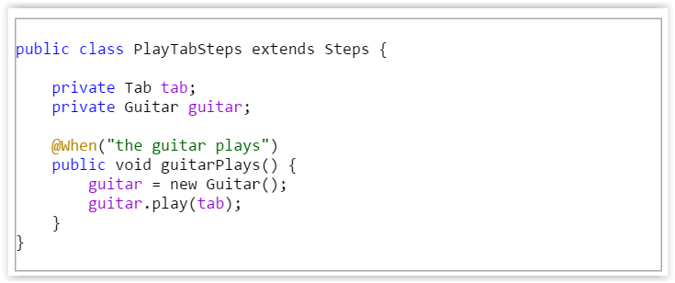
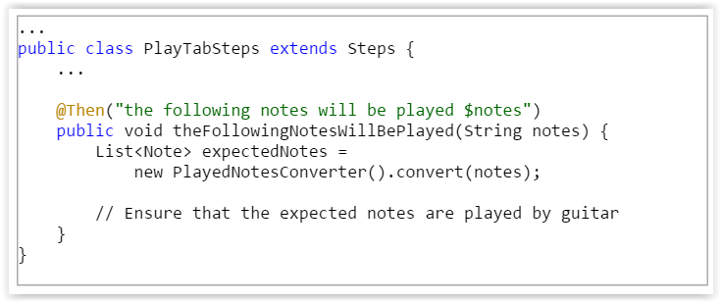
CRAFTMANSHIP PRACTICES AND PROCESSES User story/BDD/TDD by example
User story (scrum)
Scenario (BDD)
Tests (Junit/Jbehave)
Code

Slide 34

CRAFTMANSHIP PRACTICES AND PROCESSES Many kind of tests
Black box (stubs) / white box (intrusion) tests
UI/UX tests (browsing, headless…)
Performance tests (stress tests, full volume …)
Other (mutation testing, fuzz testing…)

Slide 35
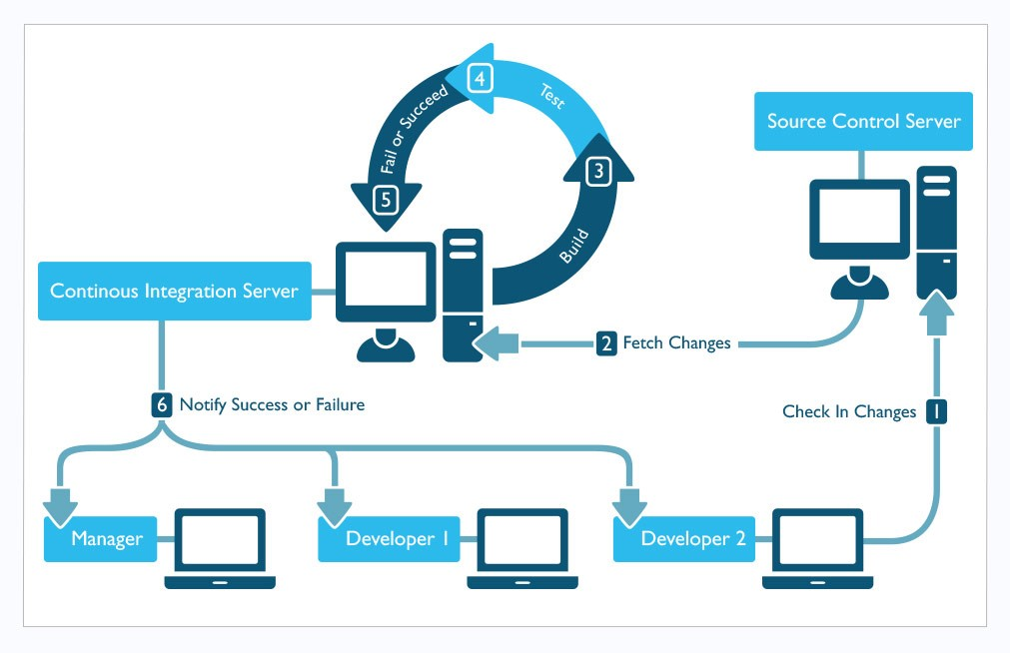
CRAFTMANSHIP PRACTICES AND PROCESSES eXtreme Programming : Continuous integration
Continuous integration is a pillar of continuous delivery
Goal : check continuously the source code produced
1. Source code change committed
2. Change detected and retrieved
3. Code built
4. Code tested
5. Result analyzed
6. Result notified

Slide 36
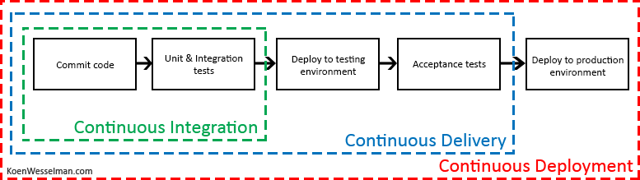
CRAFTMANSHIP PRACTICES AND PROCESSES eXtreme Programming : Continuous integration
Continuous integration is a pillar of continuous delivery …
… but this has a meaning only if everything is versioned, right?

Slide 37
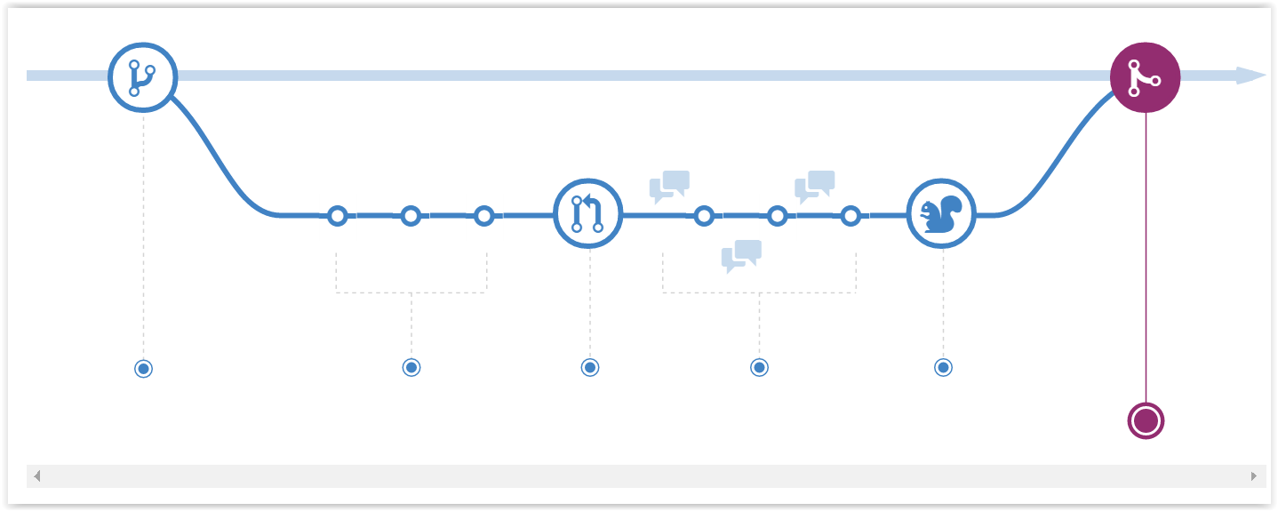
CRAFTMANSHIP PRACTICES AND PROCESSES eXtreme Programming : feature branching flow
BRANCH – COMMIT – SUBMIT – REVIEW – TEST - MERGE

Slide 38
CRAFTMANSHIP PRACTICES AND PROCESSES Quality matters
Poor quality software does NOT deserve to be delivered continuously!
Continous delivery => continuous checks on code quality
Every test pass!
Sufficient and efficient test coverage
Compliant of the architecture patterns, naming/coding conventions…

Slide 39
CRAFTMANSHIP PRACTICES AND PROCESSES many other approaches
Domain driven design
Hexagonal architecture
Microservice architecture
…

Slide 40
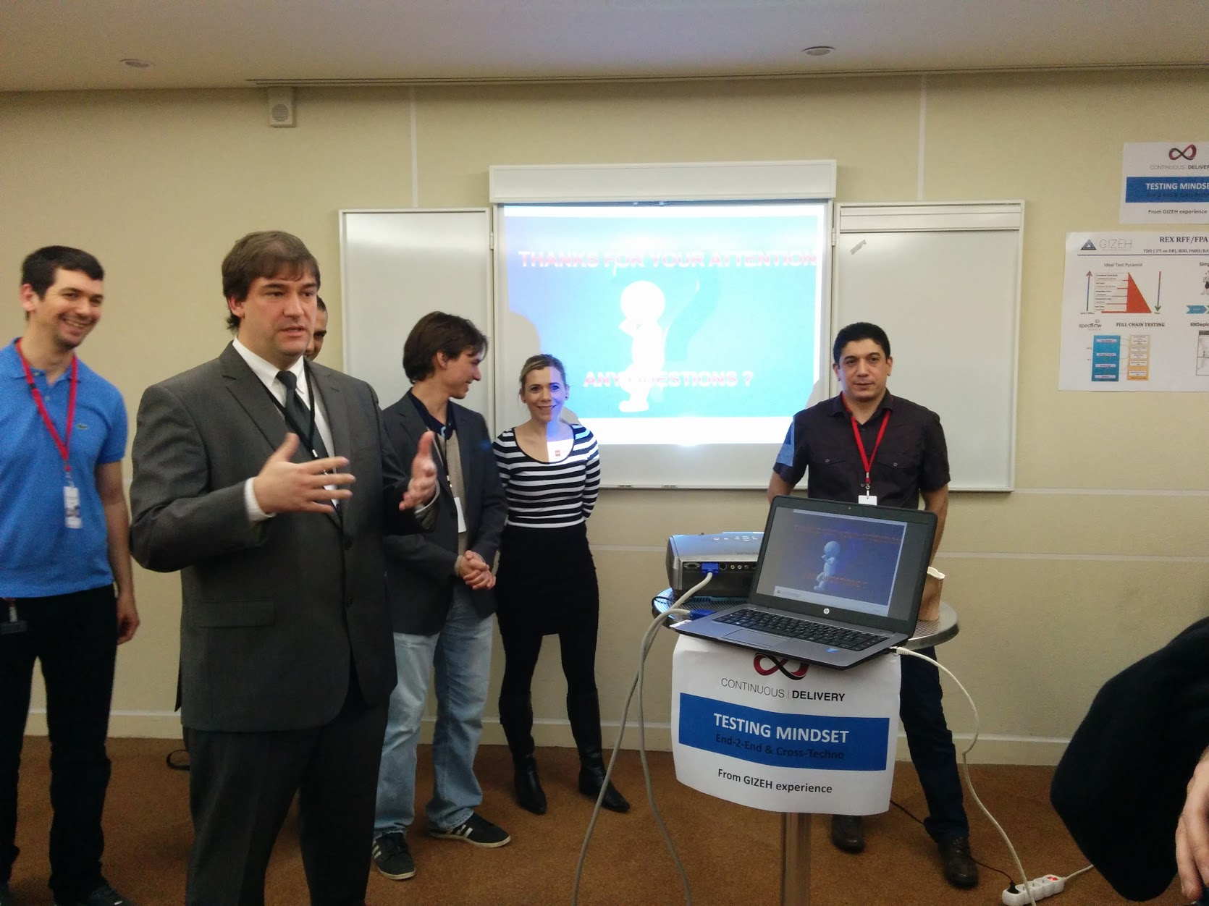


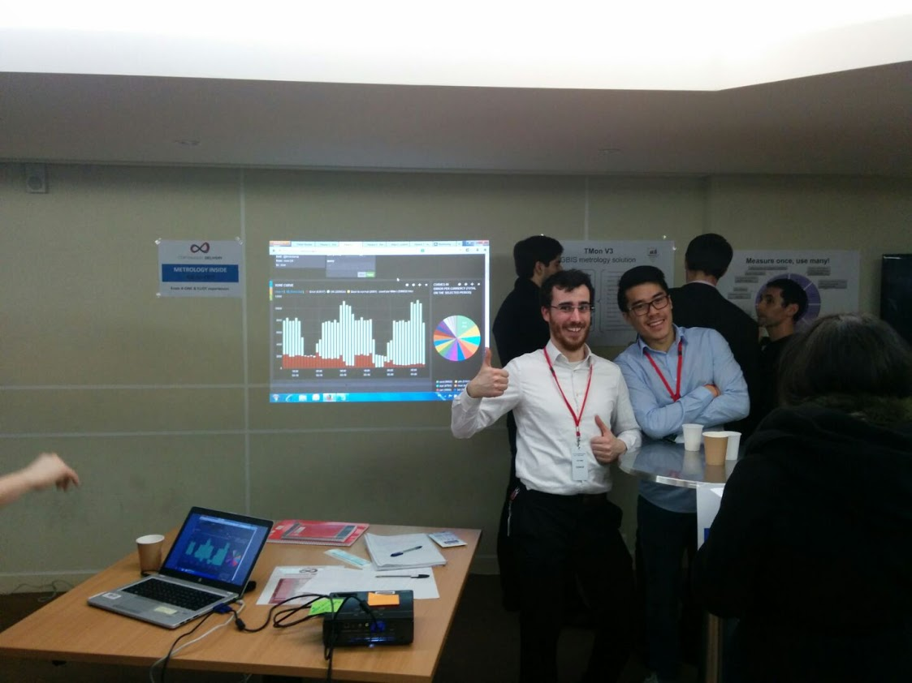
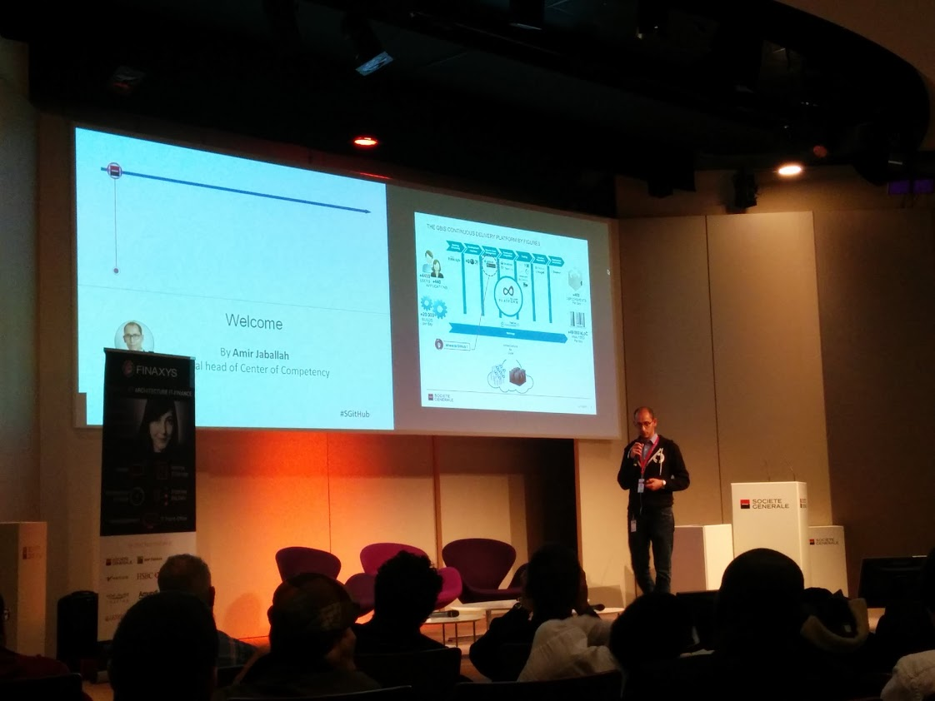
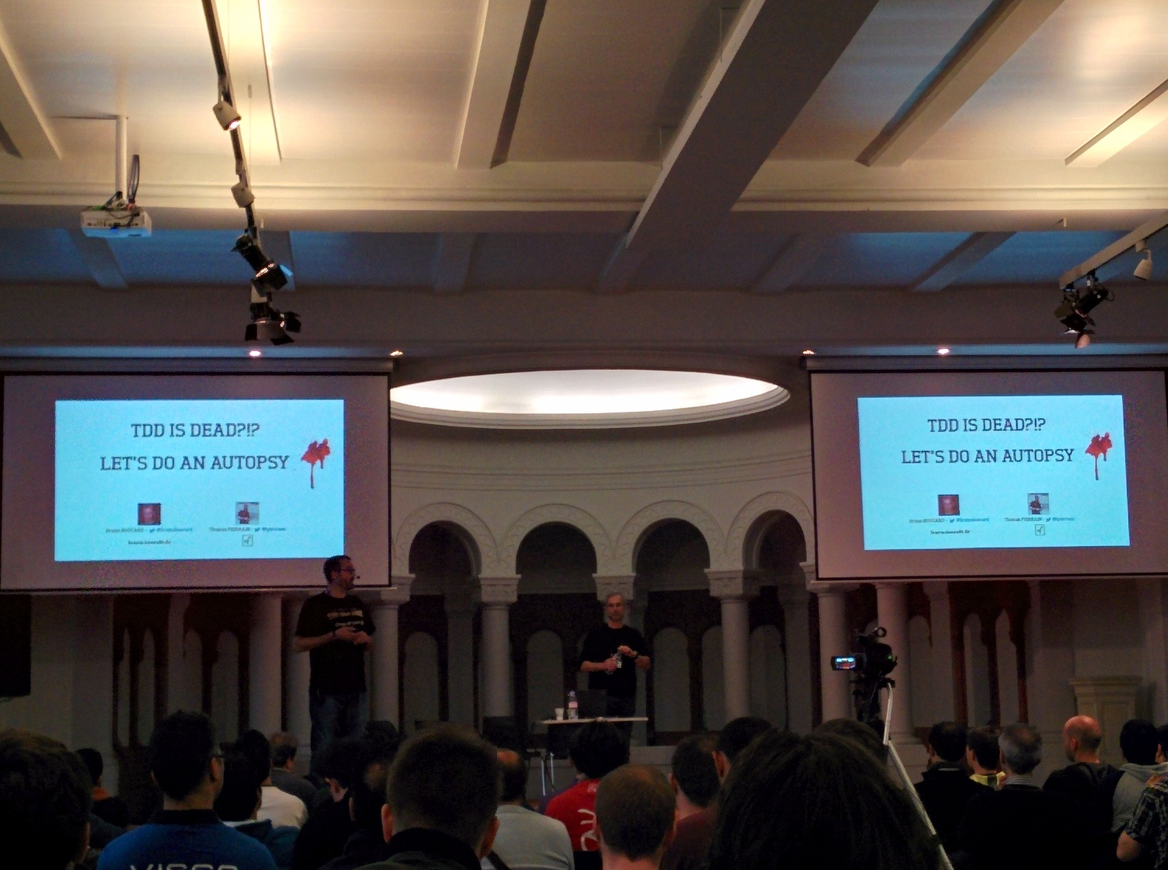
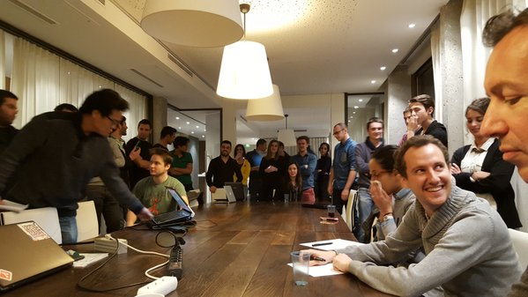
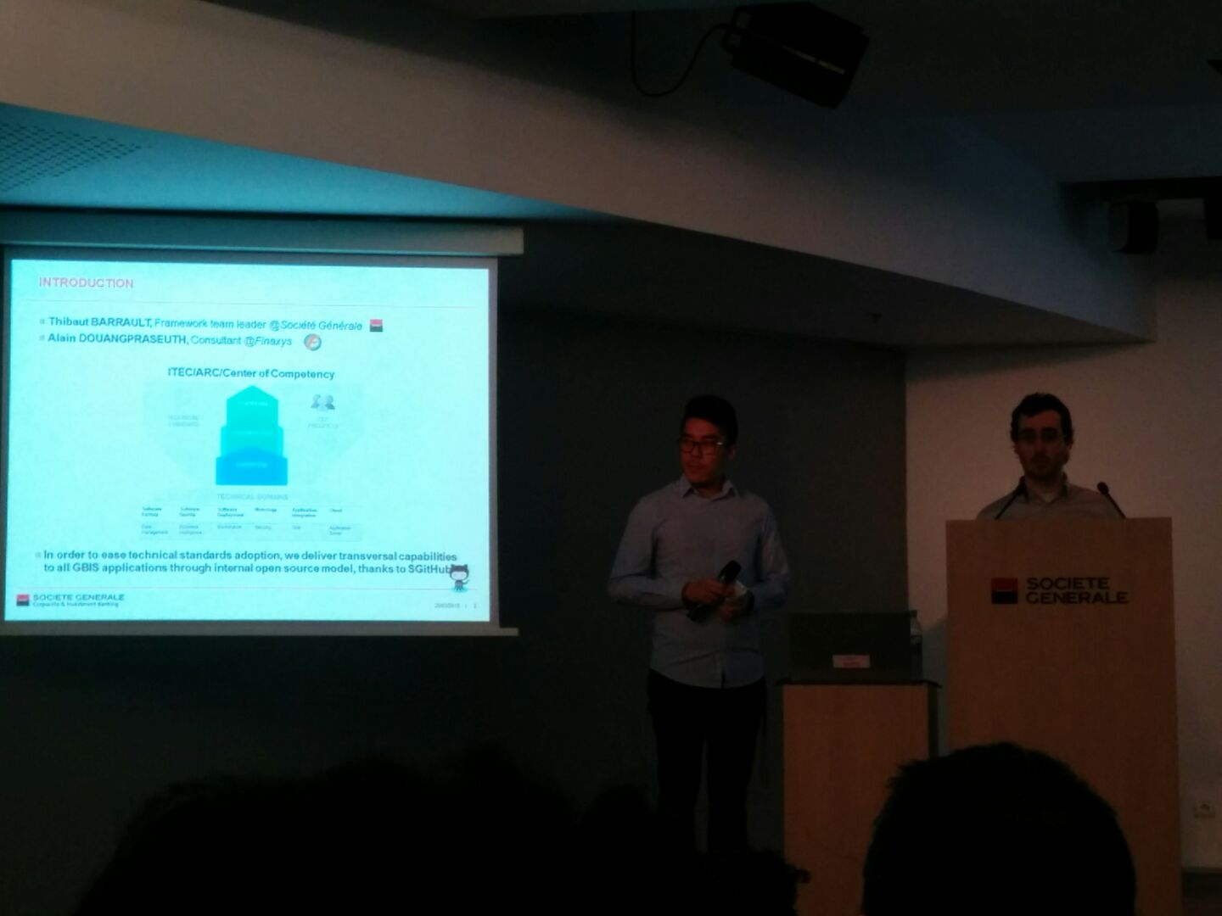
CRAFTMANSHIP PRACTICES AND PROCESSES Collaboration culture
Coding dojos
Hackatons / coding games
Meetups / fairs / conferences
Blogs
Community projects
…

Slide 41
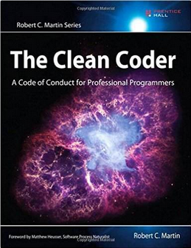
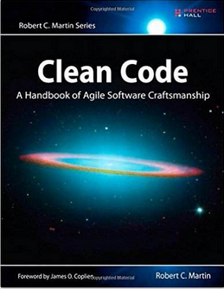
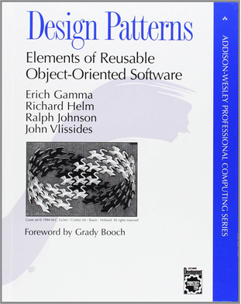
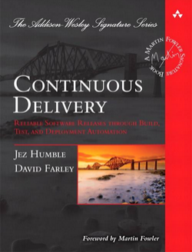

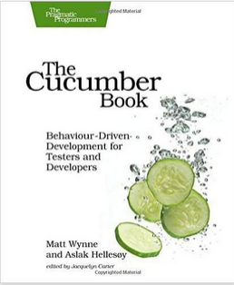




CRAFTMANSHIP How many of these books have you read?

Slide 42

Craftmanship : the sum up
Business analysts + developers + testers = same team !
A culture of collaboration
A culture of communication
A culture of team working
A culture of excellency

Slide 43
Practices and tools
Development and ops teams collaboration

Slide 44

DEVOPS : the origins
DEV…
Is feature-centric
Needs change
« yang »
OPS…
Is service-centric
Needs stability
« yin »
Opponents … but complementary

Slide 45


DEVOPS : complementary…really?
DEV
VS
OPS
…
FROM DEV SIDE

Slide 46


DEVOPS : complementary…really?
DEV
VS
OPS
…
FROM OPS SIDE

Slide 47
DEVOPS : WHY?
Duplication of tasks (same purpose, different ways)
« IT WORKS ON MY SIDE »
Frustration of the teams
« WE DID OUR JOB, IT IS THEIR FAULT »
Poor quality and time to market
« OUR IT DEPARTMENT IS A JUST A COST CENTER »
ARE DEV/OPS TEAMS REALLY BUSINESS VALUE-FOCUSED ???
WHAT IS THE COMMON « DEFINITION OF DONE » ???

Slide 48
DEVOPS : a versioning approach
How to ensure consistency between application versions used by business, developers an operation teams ?
USE THE SAME VERSION NAMING CONVENTION
How to ensure consistency between applications packaged for dev, integration, acceptance, production environments?
USE THE SAME VERSIONED APPLICATION EVERYWHERE
How to ensure versioned application will behave as expected on each environment?
USE THE SAME CONFIGURATION AND DEPLOYMENT PROCESS EVERYWHERE

Slide 49

DEVOPS : Application deployment automation
Automated deployment crosses the lines:
DEV code to deliver with OPS constraints.
OPS handle environments as code to share DEV processes.
Applications are deployed by both teams using the same tools and processes:
Only target configuration and topologic aspects differ between environments
Conception is shared, application knowledge is total from dev to production

Slide 50
DEVOPS : Application deployment automation
Automated deployment requires both dev and ops commitment
Shared : referentials, tools, achievements, vision
Respect mutual constraints, converge in a common and masterized process
Automated deployment is a way to remove legacy tools and precepts …
The best way to KIS : Keep It Simple
Make it iterative : ( 95% auto +5% manual ) > 100% automated in 2 years
NO MORE « IT WORKS ON MY SIDE » ? REALLY ?

Slide 51
DEVOPS : Environment must be versionned too
Application deployment automation itself is not enough :
Too heterogeneous environments maintained manually
Entropy increases over time, making environments unpredictable
System/middleware configuration automated by ops hidden to dev
Manage environment as source
Environment description is shared, understandable
Versionned with source, features, tests
=> NO MORE « IT WORKS ON MY SIDE » ? ALMOST …

Slide 52
DEVOPS : delivery pipeline
A linear workflow allowing automated sequence of actions on a given version
PACKAGING IS MADE IN THE GREEN PART : CONTINUOUS BUILD OF RELEASE CANDIDATES
CONFIGURATION/DEPLOYMENT OF CODE/SYSTEM/INFRASTRUCTURE IS OPERATED IN THE SAME WAY ON ALL ENVIRONMENTS
NO MORE « IT WORKS ON MY SIDE » ? YES …

Slide 53
DEVOPS : keep it simple?
Everything is versioned/packaged once, automated in the same way everywhere
… but is it really simple(r) ?
Many different process and tools to integrate (sample here)
Application is built once, but system/middleware/application configuration?
Requires mindset and toolset skills
Often unapplicable with external vendors not aligned on internal standards
IF THE « IT WORKS ON MY SIDE » WAS NOT AN ISSUE BUT ANOTHER ANSWER ?

Slide 54

DEVOPS : deliver what ?
Everything is packaged once, versioned, automated and operated in the same way … but layer per layer
System configuration
Product installation and configuration
Application build, configuration, deployment and run
IF « IT WORKS ON MY SIDE » …
WHY NOT SHIP AND DELIVER « MY SIDE » AND VOILA ?

Slide 55

DEVOPS : appliances/containers
Self-sufficient distributions with all layers (OS, middleware, libs, applications, config …)
Appliance/containers build can be described and versioned too
The « build once » is applicable to all the runtime context
Same (even better) enforcement of best practices
Development environment becomes a « real » environment
The architectures must adapt to fit : microservice, API-oriented, external configuration …

Slide 56




DEVOPS : impacts on the run
Full and isomorphic automation using appliance/containers facilitate greatly:
Blue/green+A/B testing
Canary release deployments
Automated discovery and scaling mechanisms
Feature toggling on production

Slide 57

DEVOPS : impacts on the run
Full and isomorphic automation using appliance/containers facilitate greatly:
Blue/green+A/B testing
Canary release deployments
Automated discovery and scaling mechanisms
Feature toggling on production

Slide 58


Devops : the sum up
Business analysts + developers + testers + ops = same team !

Slide 59
Practices and tools
Measurement and monitoring

Slide 60
Measurement : why ?
Already plenty of monitoring systems in place:
System
BAM
Audit trails
Log collectors …
So what’s the connexion with continuous delivery ?
Continuous delivery => MANY MORE EVENTS, ACTIONS, DATA TO PROCESS
New processes/teams to challenge => REUNIFIED DELIVERY TEAM AND BUSINESS !

Slide 61

Measurement : what is important for CD ?

Slide 62



Measurement: metrics that matters
Quality of the application
Delivery process efficiency
Live metrics on delivered features

Slide 63



Measurement : code quality
Quality matters, remember?
Put it as a blocking delivery gating criteria then!
Define acceptance criterias (global/graduated levels):
Tests results / coverage and relevance
Bug patterns detection (design, security, stability)
Coding/naming conventions
=> Analyze … and regulate!

Slide 64

Measurement : process efficiency KPIs
Time-to-market measurement
Delay between qualification and activation in production of a feature
Challenges the devs/ops/QAs delivery efficiency over time
Features usage tracking
Check of the delivered feature effective usage versus its cost
Challenges the BAs/devs analysis efficiency over time
Other KPIs
Number of defects per feature over time
% of commits passing quality criterias (i.e. : deployed/tested successfully on gating environment)
…
DEFINE YOURS

Slide 65
Measurement : live metrics
As applications are delivered often, more events occur
BA/DEV/QA/OPS teams need faster and faster feedbacks from production
Real-time analytics per feature
Performance metrics per feature
Data collection, storage and analytics models must adapt

Slide 66
Conclusion

Slide 67
Conclusion
Continuous delivery is a mean to deliver more, better, faster
It requires a set of :
Mindset
Skills
Enablers
…

Slide 68

Conclusion : and tools ?
Which tools to use ?
Inhouse versus out-of-the-box solutions?
Open source / community versus licensed?
Technology-specific versus technology-agnostic?
Central/standard versus dedicated/custom?
All-inclusive versus « à la carte » solutions?
IT DEPENDS ON THE PURPOSE …

Slide 69
































Conclusion : make your choice
TECHNICAL ORCHESTRATION
TESTS
ACCEPTANCE
PRODUCTION
DEVELOPMENT
AGILE BACKLOG MANAGEMENT
FEATURES/TESTS SPECIFICATION
SOURCE CODE DEVELOPMENT
BUILD
ENVIRONMENT/ APPLICATION PROVISIONING AUTOMATION
AUTOMATED TESTING
MEASUREMENT / METROLOGY

Slide 70

Questions ?

Slide 71


